Slide 1


Simulating SNN’s
By Armin khayati

Slide 2
SNN simulation packages
Many spiking neural network frameworks exist, each with a unique set of use cases.
Some focus on the biologically realistic simulation of neurons, while others on high-level spiking network functionality.
To build a network to run even the simplest machine learning experiment, one will face multiple difficult design choices: Which biological properties should the neurons and the network have? e.g., how many GABAergic neurons or NMDA/AMPA receptors should be used, or what form of synaptic dynamics?
Several prominent SNN simulation packages are compared in next Table

Slide 3
SNN simulation packages
For example, NEST (Gewaltig and Diesmann, 2007), BRIAN (Stimberg et al., 2014), and ANNarchy (Vitay et al., 2015) focus on accurate biological simulation from sub-cellular components and biochemical reactions, to complex models of single neurons, all up to the network level.
Other popular biologically realistic platforms are NEURON (Carnevale and Hines, 2006), Genesis (Cornelis et al., 2012). These simulation platforms target the neuro-biophysics community and neuroscientists that wish to simulate multicompartment neuron models, in which each compartment is a different part of the neuron with different functionalities, morphological details, and shape.

Slide 4
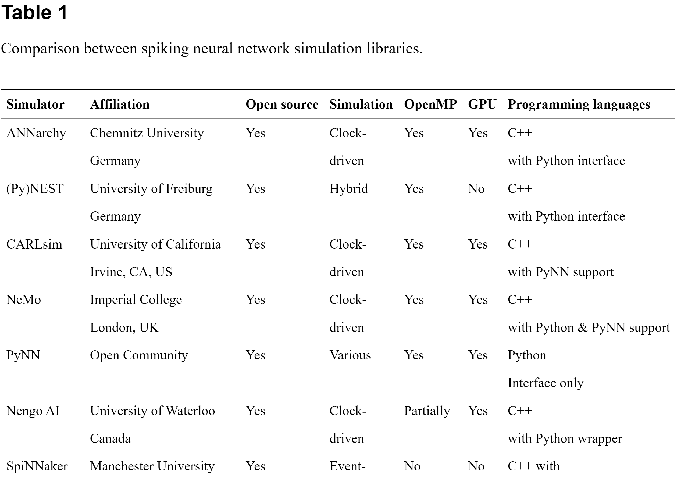

Slide 5
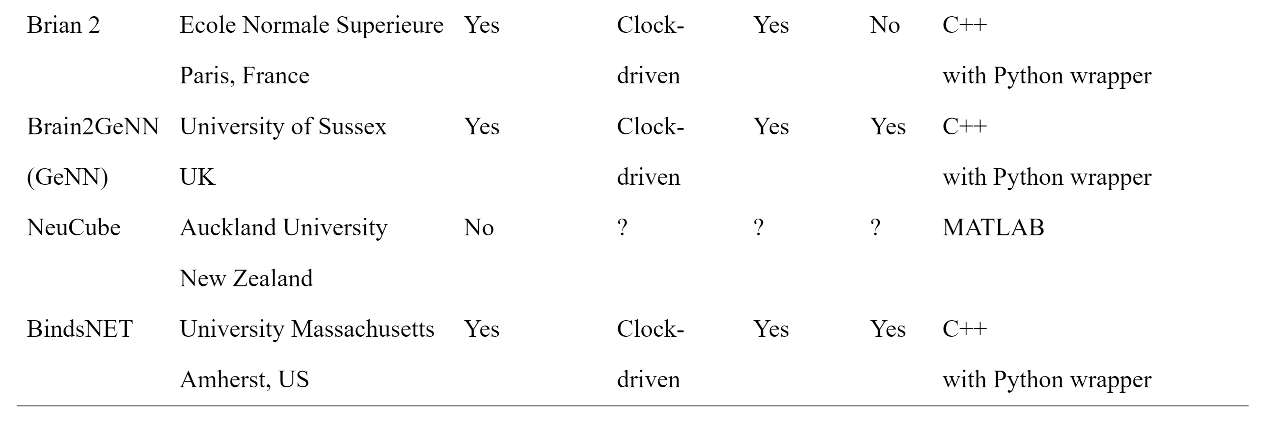

Slide 6
SNN simulation packages
A major benefit of the BRIAN, ANNarchy, NEST, and NEURON packages is that, besides the built-in modules for neuron and connection objects, the programmer is able to specify the dynamics of neurons and connections using differential equations.
The equations are compiled into fast C++ code in the case of ANNarchy, vectorised and linear algebraic operations using NumPy and Basic Linear Algebra Subprograms (BLAS) in the case of BRIAN2, and to a mix of Python and native C-like language (hoc) (Hines et al., 2009) which are responsible for SNN simulation in the case of NEURON.
In addition, in the NEST package, the programmer can combine pre-configured objects (which accepts arguments) to create SNNs.
At this time, BindsNET does not support the solution of arbitrary differential equations describing neural dynamics, rather, for simplicity, several popular neuron types are provided for the user to chose from.

Slide 7
SNN simulation packages
Frameworks such as NeuCube (Kasabov, 2014) and Nengo (Bekolay et al., 2014) focus on high-level behaviors of spiking neural networks and may be used for machine learning experimentation.
NeuCube attempts to map spatiotemporal input data into three-dimensional SNN architectures; however, it is not an open source project, and therefore is somewhat restricted in scope and usability.

Slide 8
SNN simulation packages
Nengo is often used to simulate high-level functionality of brains or brain regions, as a cognitive modeling toolbox implementing the Neural Engineering Framework (Stewart, 2012) rather than a machine learning framework
Nengo is an open source project, written in Python, and supports a Tensorflow (Abadi et al., 2015) backend to improve simulation speed and exploit some limited ML functionality.
It also has options for deploying neural models on dedicated hardware platforms; e.g., SpiNNaker (Plana et al., 2011). CARLsim (Beyeler et al., 2015) and NeMo (Fidjeland et al., 2009) also focus on the high-level aspects of SNNs and are thus good candidates for applications in machine learning.

Slide 9
SNN simulation packages
The GeNN (GPU-enhanced neuronal networks) library Yavuz et al. (2016) is an environment that enables simulation of SNNs on CPUs or NVIDIA GPUs via code generation technology.
Networks are defined in a C-style API, and the code for simulating them (on CPU or GPU) are automatically generated by GeNN.
The recent BRIAN2genn package Stimberg et al. (2018) (in beta release) can be used to convert network models written in BRIAN2 to run on NVIDIA GPUs using the GeNN library, by invoking BRIAN2's set_device() function to execute code in an external framework.
Although this platform targets both CPUs and GPUs (a central feature of the BindsNET library), it requires an (often costly) intermediate code generation step between network prototyping and deployment.
It is also difficult to intervene on the generated code when running; e.g., clamping synapses if certain criteria are met, or changing learning rates as the simulation progresses.

Slide 10
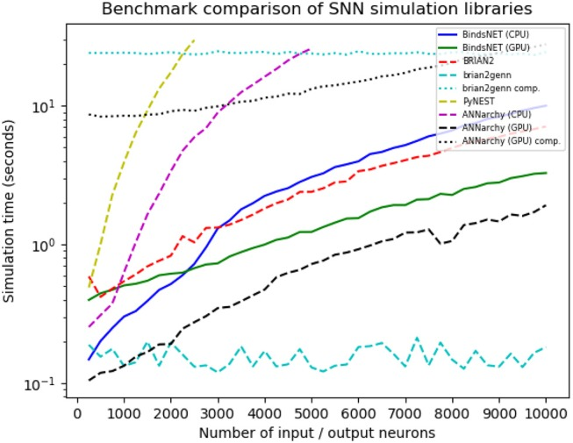
Benchmark
Benchmark comparison results from a number of SNN simulation frameworks. Variability in benchmarked times is likely due to randomness in the simulation and fluctuations in CPU load.

Slide 11
SNN simulation packages
If such frameworks are not tailored to the needs of a user, have steep learning curves, or aren't flexible enough to create a desired model, the user may have to program in both high- and low-level languages to make changes to the required internal components.
The authors have encountered this difficulty with the BRIAN2 library in particular, since certain segments of simulation functionality is regulated to generated code, which is difficult or impossible to modify while, for example, training a SNN for a machine learning task.
This issue is likely to appear in similar software frameworks; e.g., GeNN and ANNarchy.

Slide 12
SNN simulation packages
BindsNET relies on PyTorch for its matrix computations in order to perform efficient simulation of spiking neural networks. Without changing the details of the mathematical operations, BindsNET can in principle be connected to various hardwares, e.g., FPGA, ASIC, DSP, or ARM, to execute the simulations.
One may design an API to compile spiking networks created in BindsNET to run on designated hardware instead of using PyTorch as the simulation workhorse.
In this way, BindsNET can be seen as a bridge between the software and hardware domains, enabling researchers to rapidly test software prototypes on CPUs or GPUs, and eventually deploy the simulation to fast, energy efficient dedicated hardware.

Slide 13
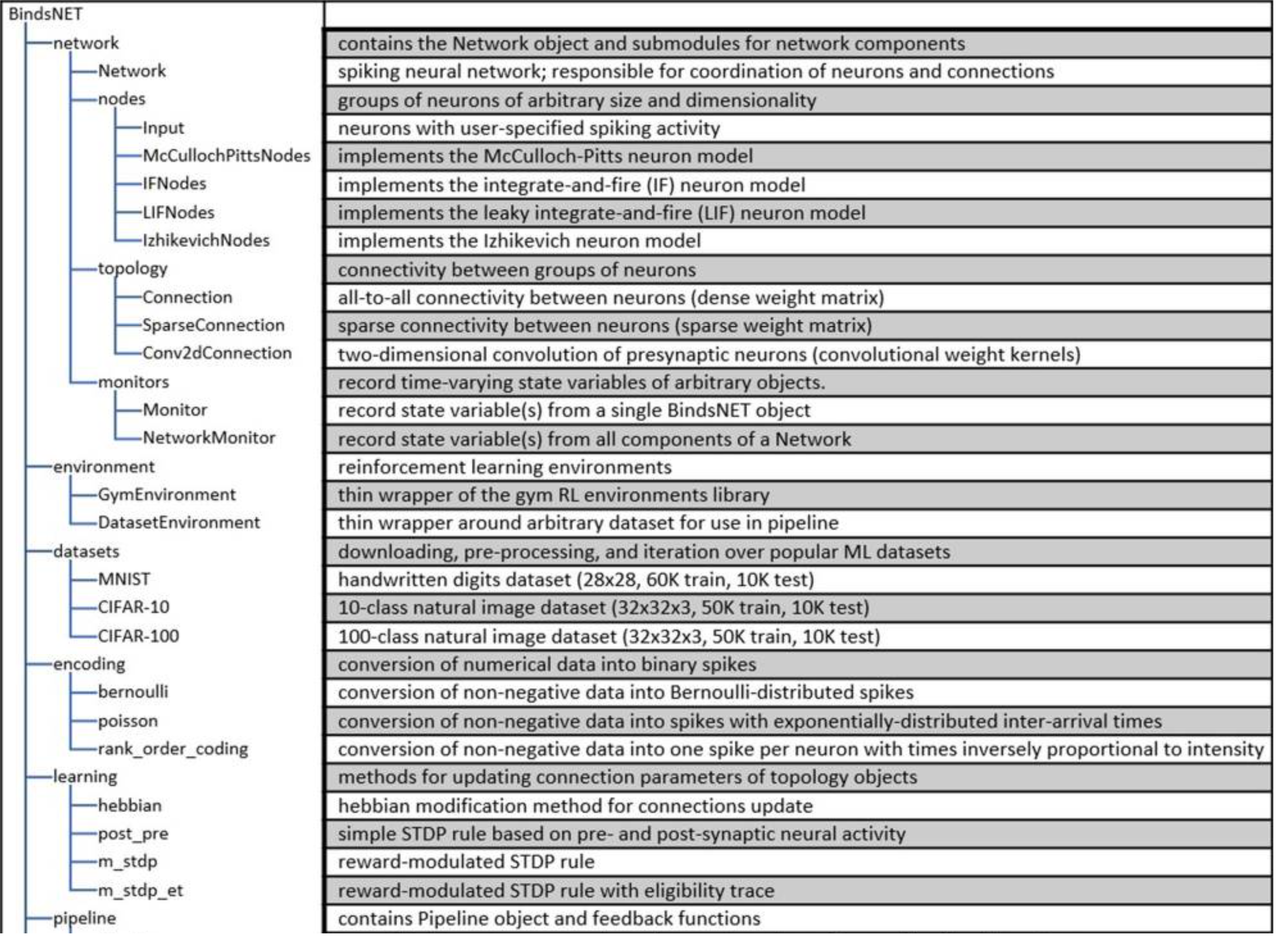

Slide 14
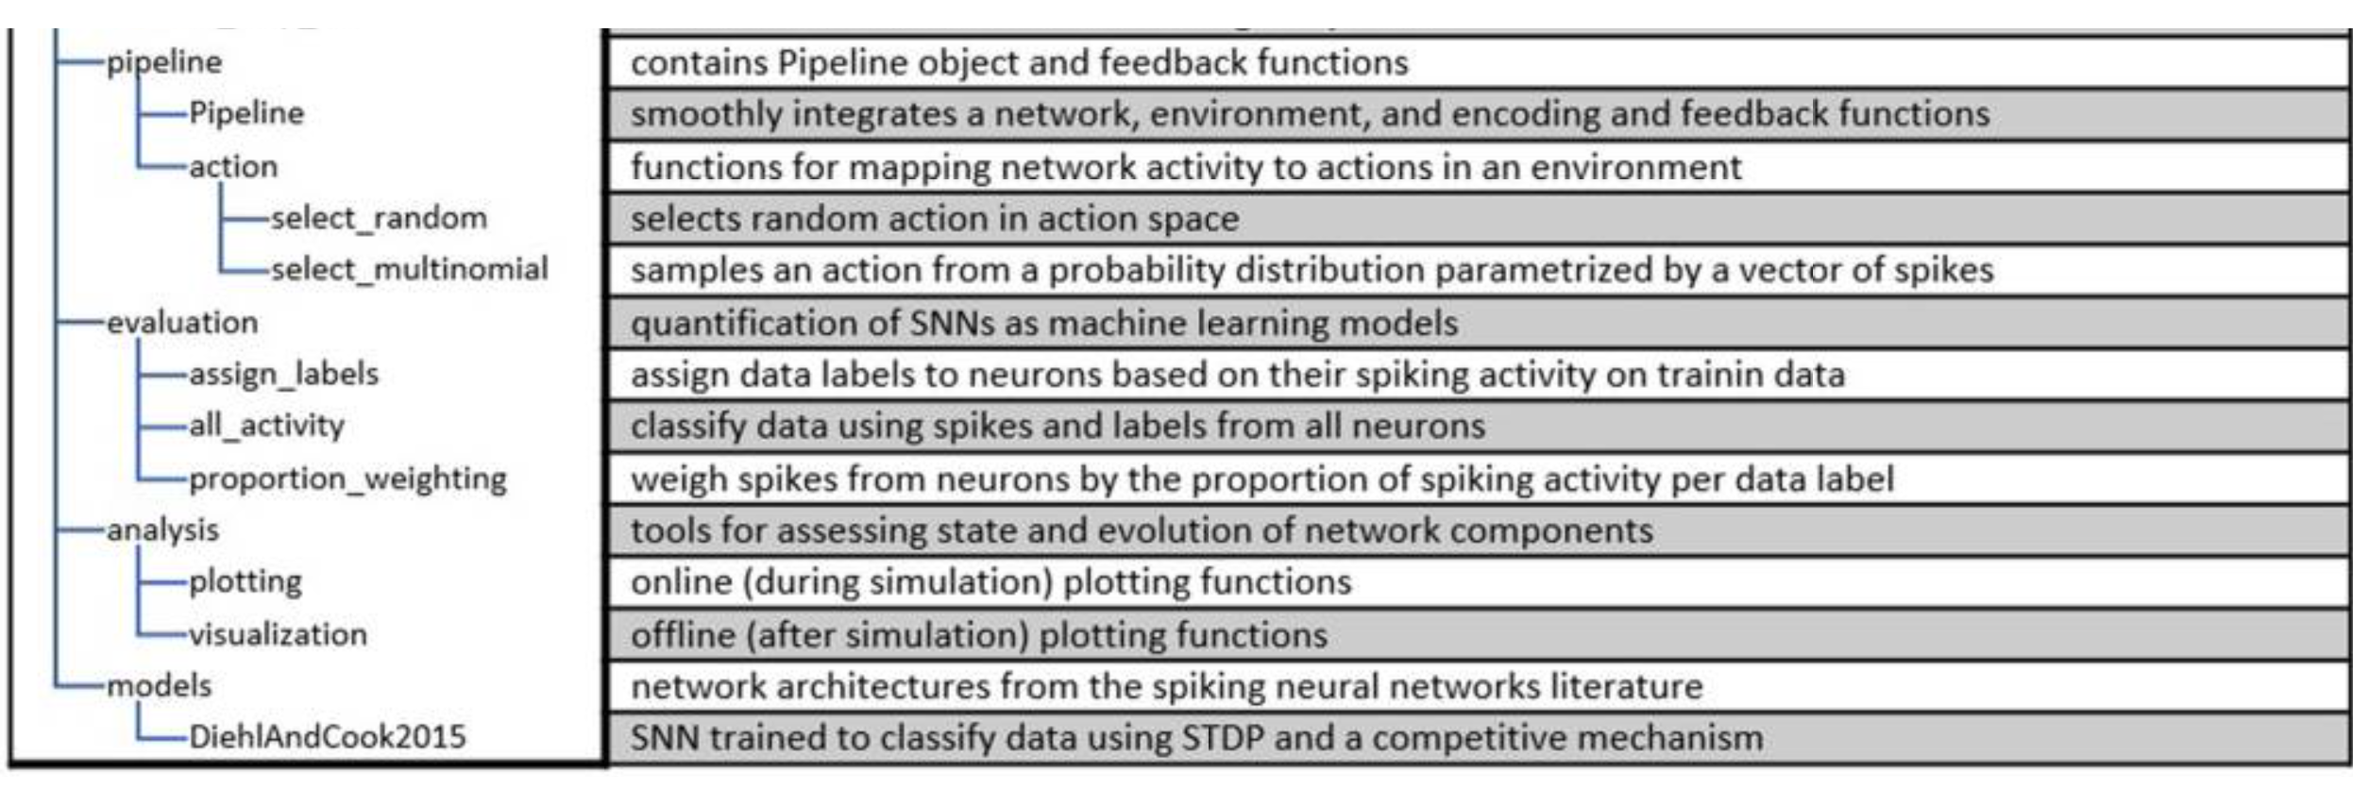

Slide 15
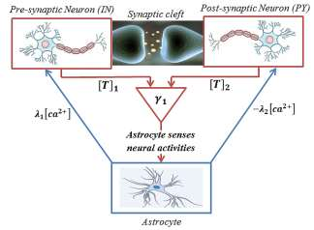
Astrocytes
Astrocytes are a population of cells with distinctive morphological and functional characteristics that differ within specific areas of the brain.
They have a regulatory role in brain functions and play several other important roles in the central nervous system.
Astrocytes can sense neuronal transmissions and respond with releasing gliotransmitters and thus “listen and respond” to the synapses and locally regulate neural information processing which leads to propose the concept of "tripartite synapse“.

Slide 16
Astrocytes
Synchronization processes have the crucial importance for brain functions.
Well-coordinated synchrony within and between neuronal populations appears to be an important mechanism for neuronal signaling and information processing .
On the other hand, epilepsy and Parkinson have been historically seen as the functional brain disorders that have associated with excessive synchronization of large neuronal cortical populations leading to a hyper-synchronous state.

Slide 17
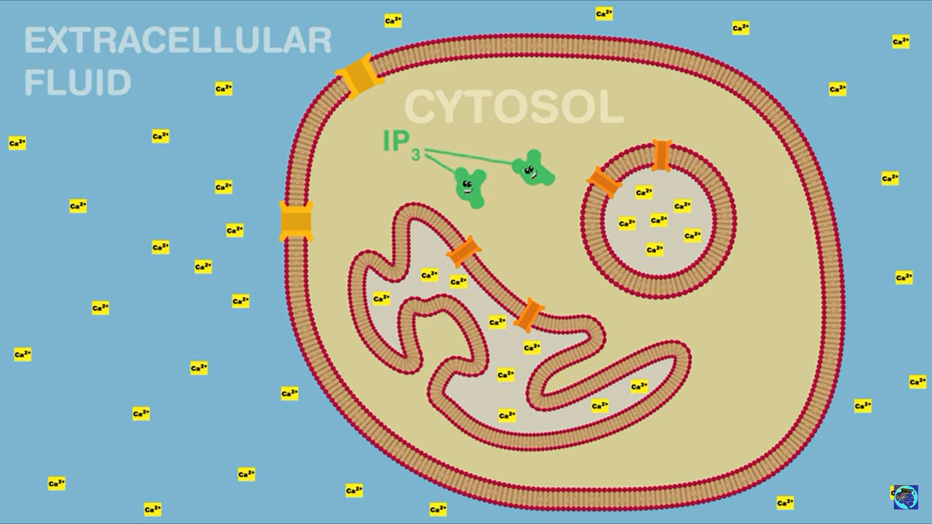
Astrocytes
Astrocytes cannot generate action potentials, i.e., the astrocytes are non-excitable electrically but, they can be considered as an active processing element, which communicate closely with neurons.
Recent studies have demonstrated that astrocyte is capable of changing the threshold value of transition from synchronous to asynchronous behavior among neurons.
Astrocytes respond to the neurotransmitter release in the synaptic cleft through IP3 production. Subsequently, elevation of IP3 concentration induces the release of calcium from endoplasmic reticulum (ER), and then more calcium is released depending on the IP3 induced calcium elevation.
The elevation of calcium above a certain threshold triggers the release of glial transmitters, which, in turn, will influence the dynamics of the neurons.

Slide 18
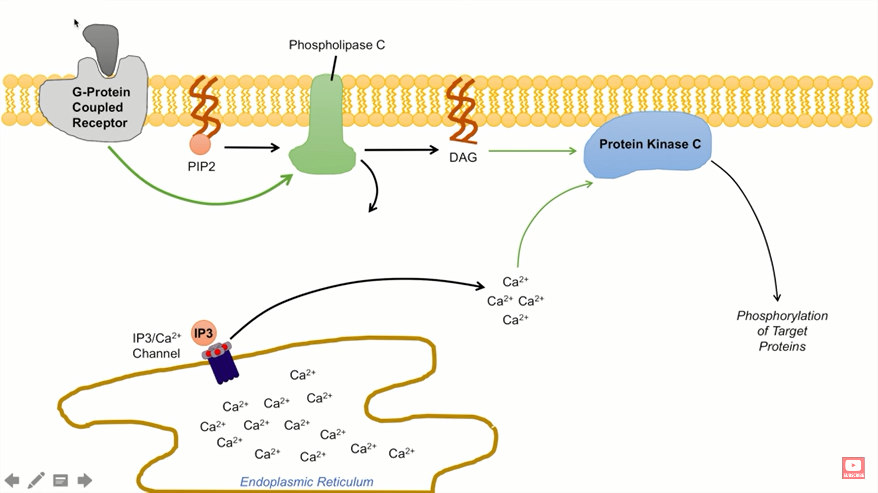

Slide 19
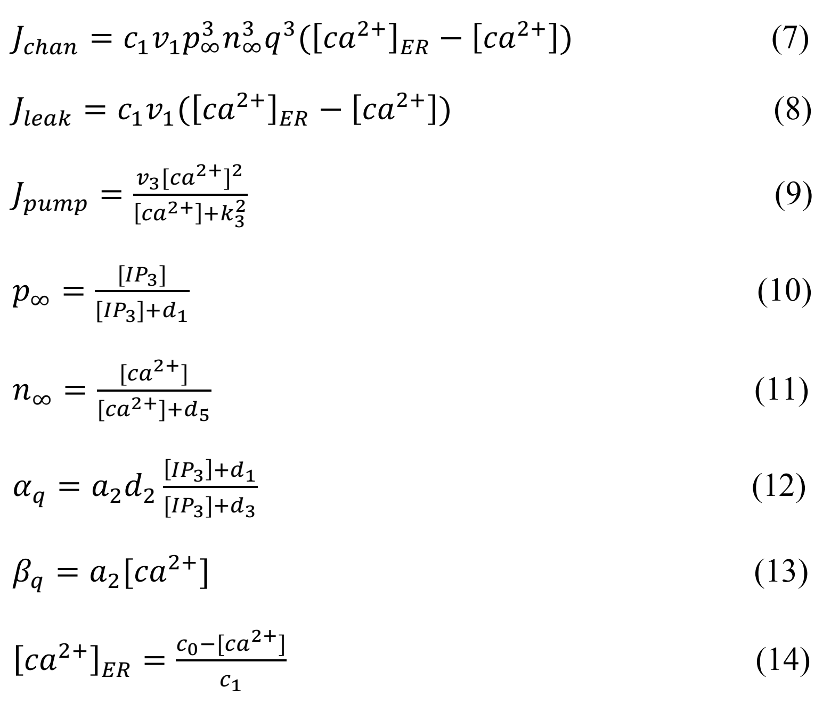
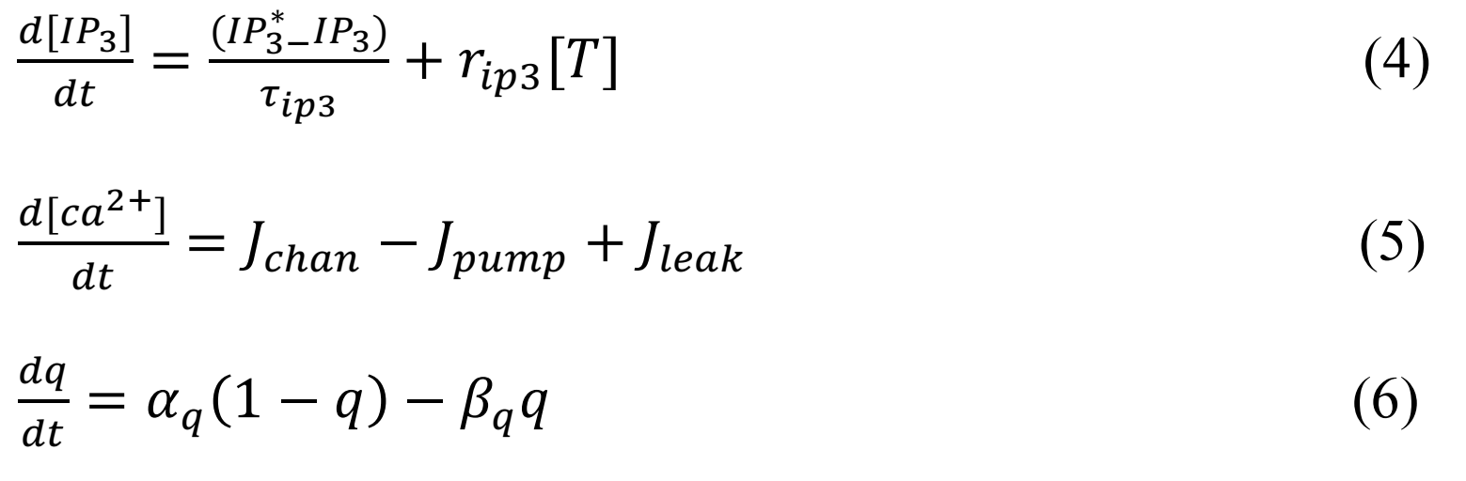
Li-rinzel astrocyte model

Slide 20
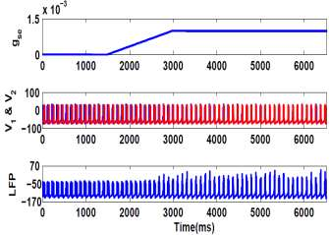
Astrocyte stimulation as a new technique to desynchronize two coupled neurons
Astrocyte has a key role in controlling synchronization level through intermediacy in synaptic transmissions.
In order to synchronize neural firing, we increase the interaction between neurons by increasing the coupling coefficient ( according to the first panel of Fig.2).
As shown in the second panel of Fig, with increasing at t=1500ms from 0 to 0.0001, two neurons become synchronized.
In this case, we have considered open loop system in Fig.1 which means that astrocyte has no interaction with neurons ( landa1=landa2=0).
In the third panel of the Fig.2, we show LFP as the sum of the membrane voltage of the neurons [18]. When two neurons are synchronized, increasing in the amplitude of the LFP can be observed

Slide 21
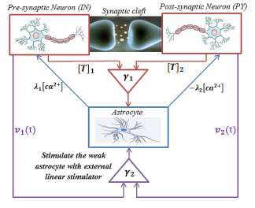
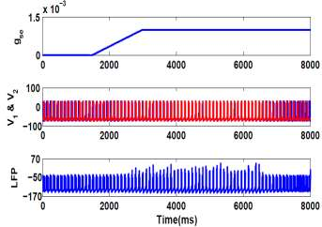
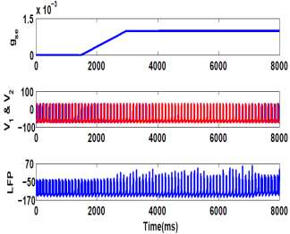
Astrocyte effect
The effect of astrocyte in tripartite synapse. When astrocyte has active interaction with neurons (t>6500ms), it can provide appropriate feedback signal to shift firing of neurons from a synchronized state to the asynchronous state. The amplitude of LFP is also reduced, when astrocyte begins its interaction with neurons.
The effect of weak astrocyte in tripartite synapse. When astrocyte has weak interaction with neurons , the normal activity cannot be reoccurred.

Slide 22
we designed the tripartite synapses network, which astrocytes dominate the synaptic spaces.
Then, the network has been trained on MNIST dataset.
We attempted to build computational and biologically inspired neuronal population model of a large-scale, sparsely connected tripartite synapses population, which consists of 2500 excitatory pyramidal neurons (PY), 2500 inhibitory interneurons (IN) and 2500 astrocyte (means that 2500 tripartite synapses) with millions of excitatory and inhibitory synapses and gap junctions.
The tripartite synapses network has trained on the MNIST dataset based on the spike-based learning by updating the values of the GABA and AMPA synaptic strength in an unsupervised fashion using spike time-dependent plasticity (STDP).

Slide 23
Astrocyte effect on classification
Appropriate neuron–astrocyte interaction enables astrocyte to compensate the abnormal increase of excitation level within the neuronal population and can be effectively protected neurons from hyper-synchronous oscillation.
Subsequently, defects in astrocyte function disrupt the interaction of neuron with astrocyte, which in turn causes imbalance in synaptic transitions and subsequently an increasing level of excitation in neuronal population.
Change in the effects of astrocyte on synaptic activity or the so-called impairing astrocyte greatly diminishes the accuracy of pattern recognition of the impaired tripartite synapses. (The rate of correct recognition decreased from 95% to 79.06%.)

Slide 24
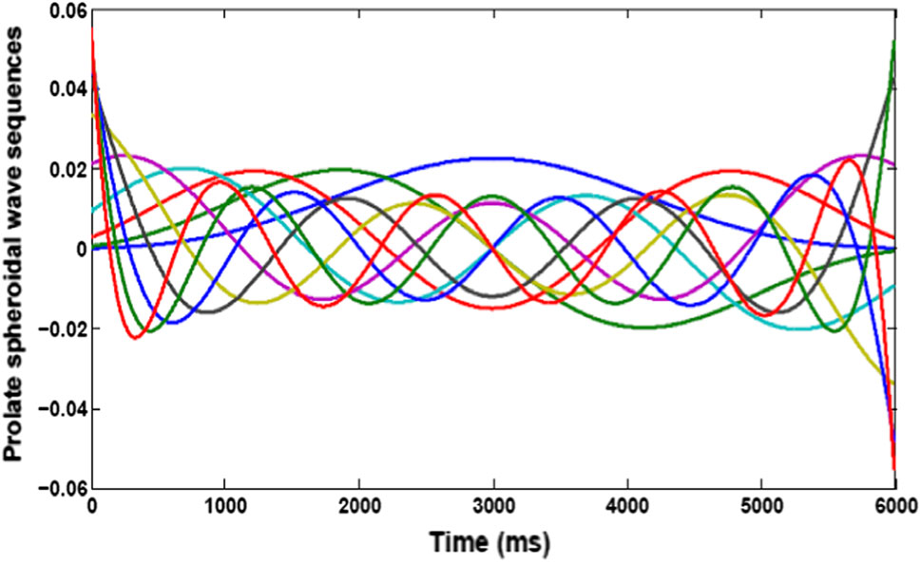
Training and classification accuracy of tripartite synapses network
Prolate spheroidal wave functions (PSWFs) are the bandlimited energy concentrated signals, which were first studied by Slepian.
These functions have been considered as a particular type of spheroidal wave function.
PSWFs direct us to find the maximum energy of the signal in a fixed time interval and bandlimited frequency, which is a powerful tool in the information theory and engineering applications.
Prolate spheroidal wave sequence consists of sine signals with different amplitude, frequency and phase. Ten sequences of PSWF are shown in Fig.

Slide 25
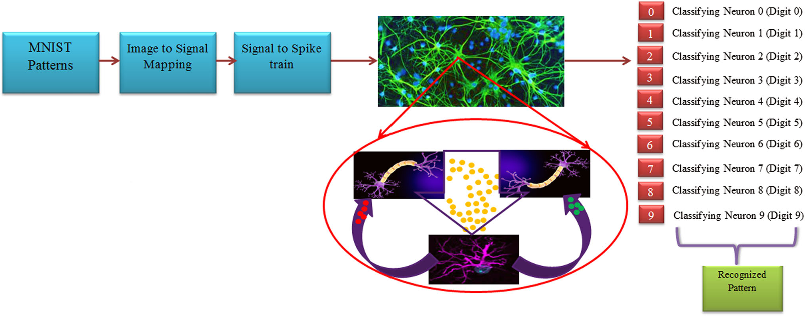
Training and classification accuracy of tripartite synapses network
As shown in Fig, in the training and testing procedure, the obtained signal from image is injected to tripartite synapses network.
Encoding the information of the image pixels into the frequency, phase and amplitude of the sine signals gives us a series of sine signals similar to the sequence of PSWFs. Image-to-signal conversion for each pixel translates the horizontal position into phase, vertical position into frequency and brightness into oscillations amplitude of the sine signal (Nazari et al. 2018).
In fact, we have transformed the image pixels into a set of sequences of PSWF.

Slide 26
Training and classification accuracy of tripartite synapses network
Informative signal of image has been applied to the network of tripartite synapses through the time-varying rate of Poisson spike trains.
We consider ten pyramidal neurons as classifying neurons and connect them to all neurons of tripartite synapses network.
Then, tripartite synapses and classifying neurons have beentrained on the training set of MNIST (60,000 samples).
The training procedure has been repeated ten times.
Training of tripartite synapses network has been unsupervised except the last step, which is based on the highest firing activity to each class of digit, and one output neuron is assigned to each input pattern.

Slide 27
Performance of the impaired tripartite synapses network
Simulation results of the accuracy of the tripartite synapses in MNIST recognition show that three different modes have been observed in the results:
Correct learning: The classifying neurons fire proportional to the input digits
Some mistakes: The classifying neurons do not correctly detect their corresponding input
Always firing The classifying neurons continuously fire regardless of the input pattern

Slide 28
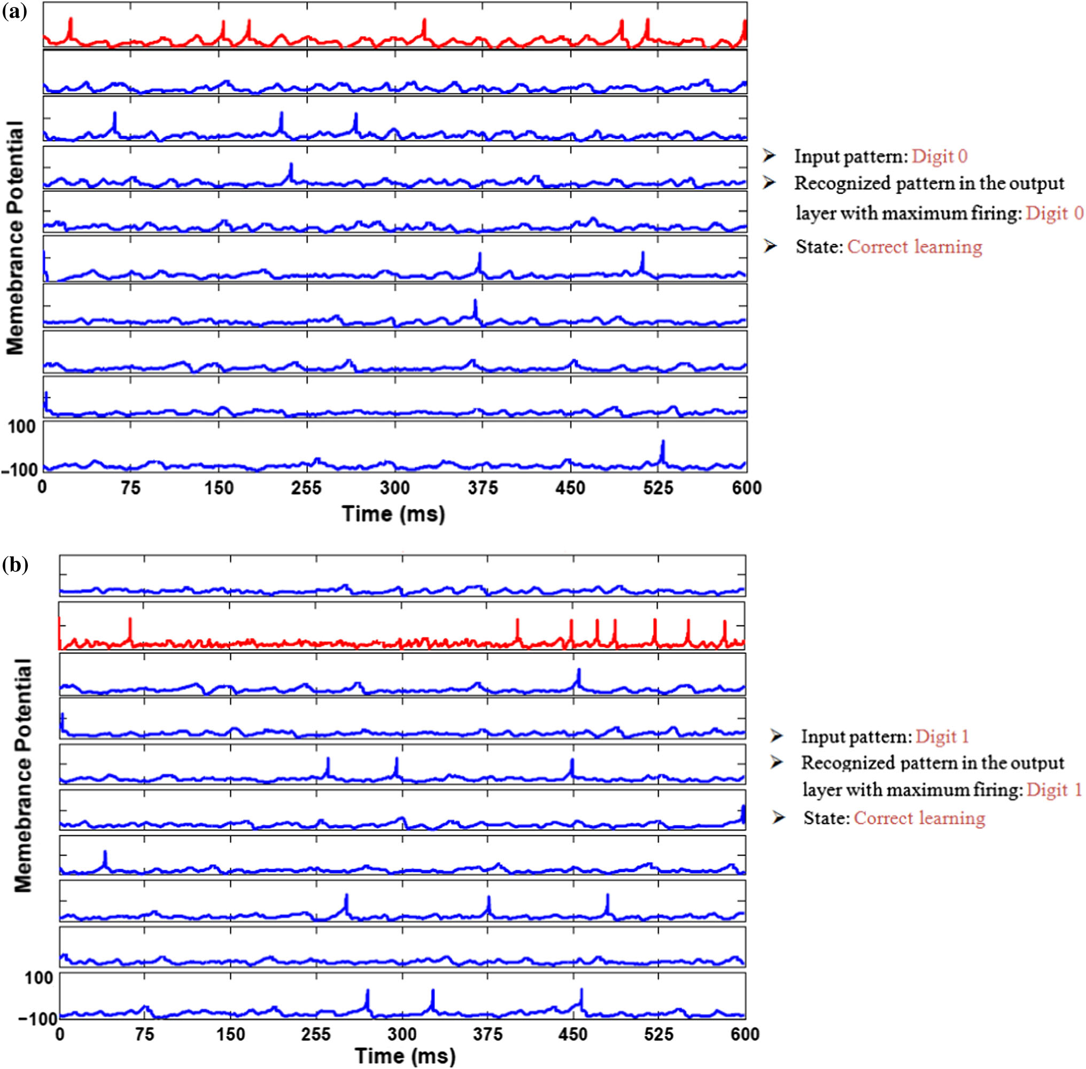
Performance of the impaired tripartite synapses network
a, b Spike pattern of classifying neurons by presenting digit-tests 0,1 to the input, respectively. The results are evidence of the performance accuracy of the network.

Slide 29
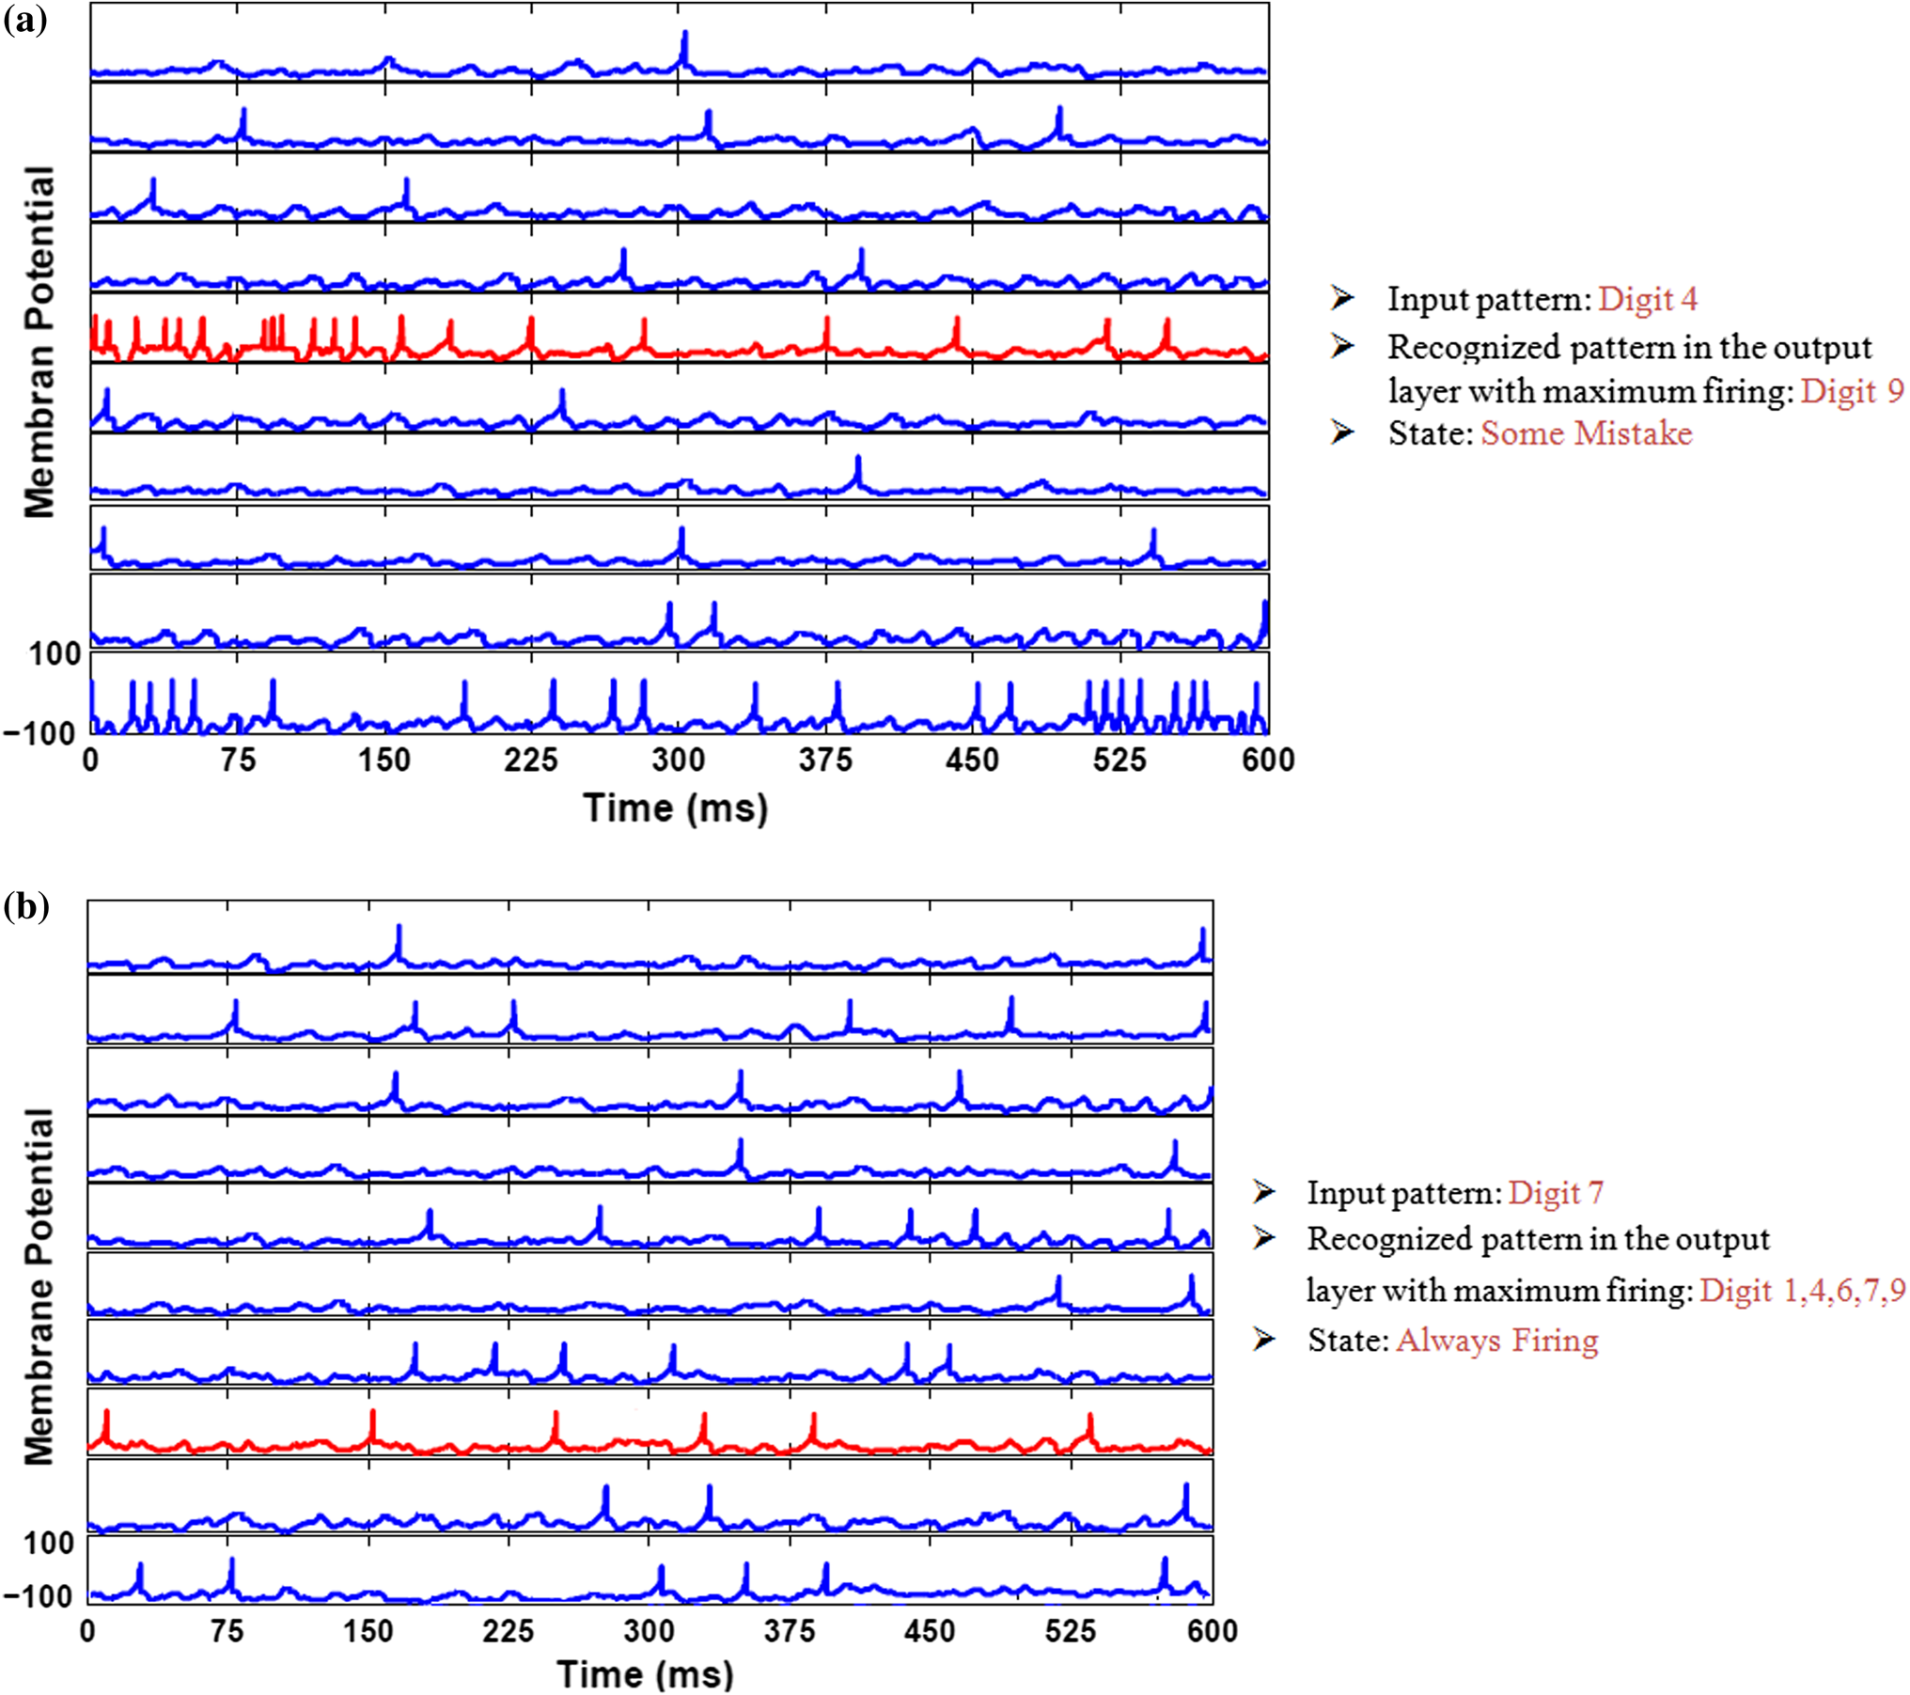
Performance of the impaired tripartite synapses network
Performance error when (a) classifying neurons cannot correctly perform the categorization and (b) classifying neurons continuously fire regardless of the input pattern.

Slide 30
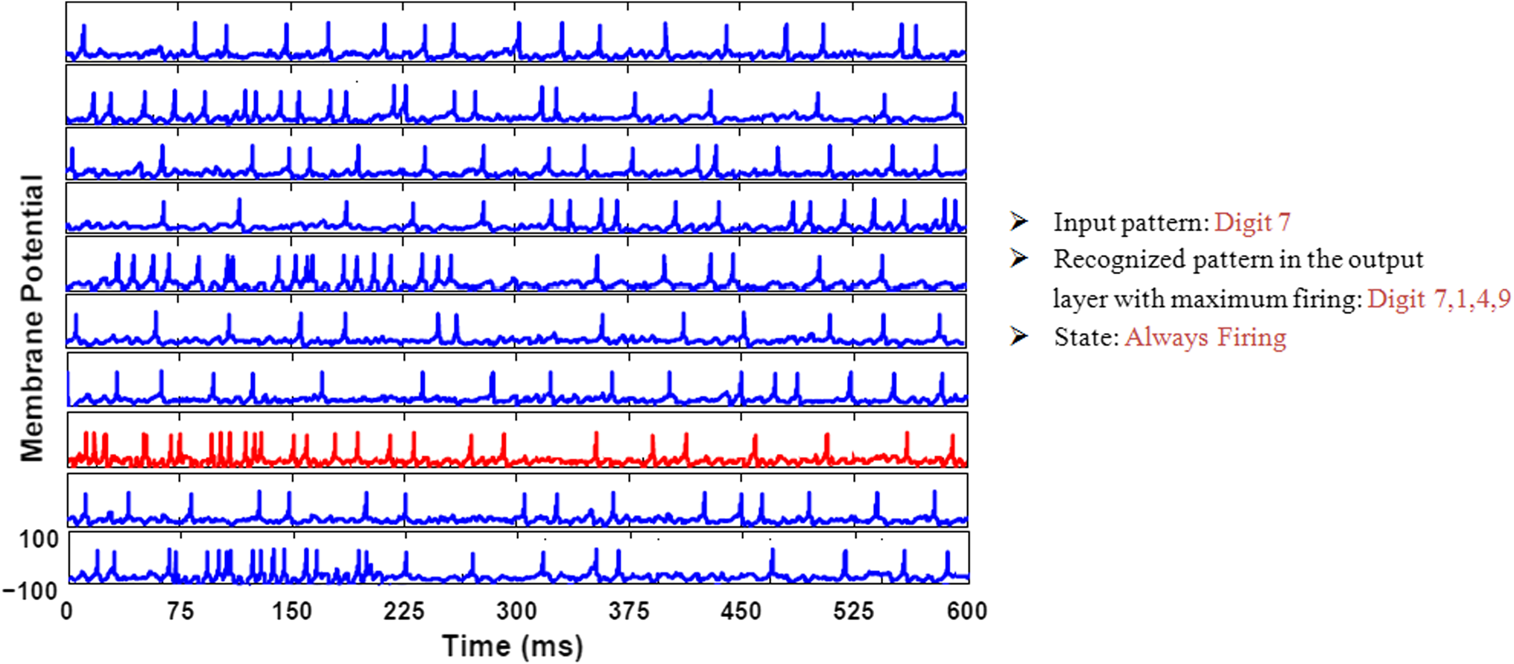
Performance of the impaired tripartite synapses network
Healthy astrocyte reduces Always firing mod unlike the network without astrocyte.
Impaired astrocyte increases Always firing mod unlike the network with strong astrocyte.
Classifying neurons due to the weak astrocytes of the impaired tripartite synapses network continuously fire regardless of the input pattern

Slide 31
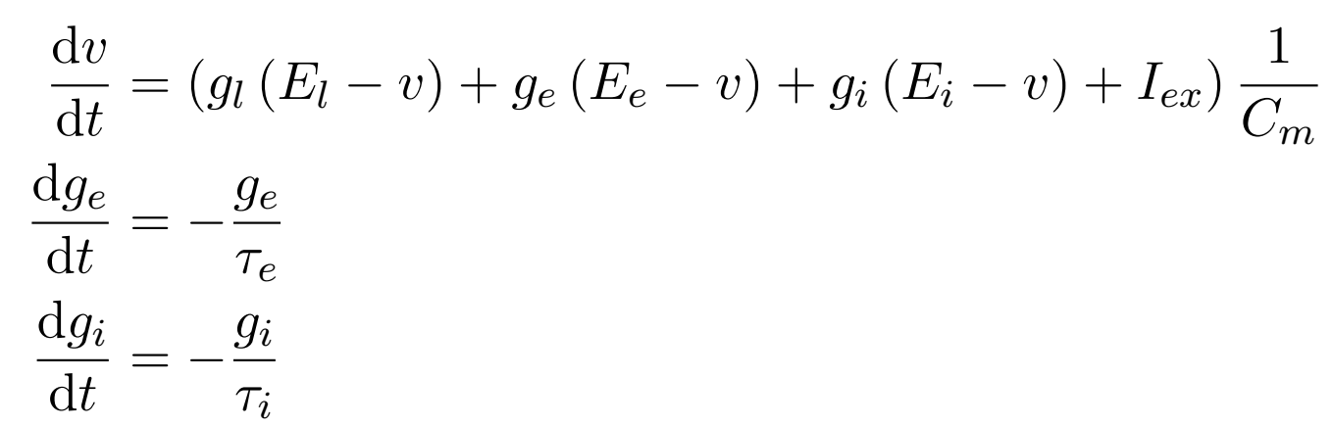
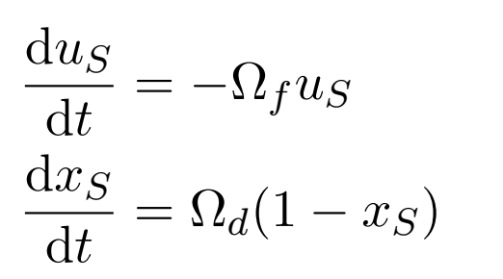
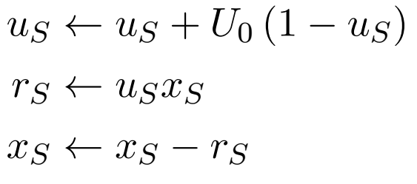
Brian 2 Simulation
Neuron Model: the simple model of an integrate-and-fire neuron with conductance-based excitatory (ge) and inhibitory synapses (gi) and a constant input current I_ex.
The synaptic release is modeled by the product of two variables uS and xS, where uS loosely relates to the neurotransmitter resources docked for release by the Ca2+ sensor for synaptic exocytosis of neurotransmitter, and xS represents the fraction of total neurotransmitter available for release.
Between action potentials, uS decays to 0 at rate Ωf while xS recovers to 1 at rate Ωd, i.e.
# post-synaptic excitatory conductance
# post-synaptic inhibitory conductance

Slide 32
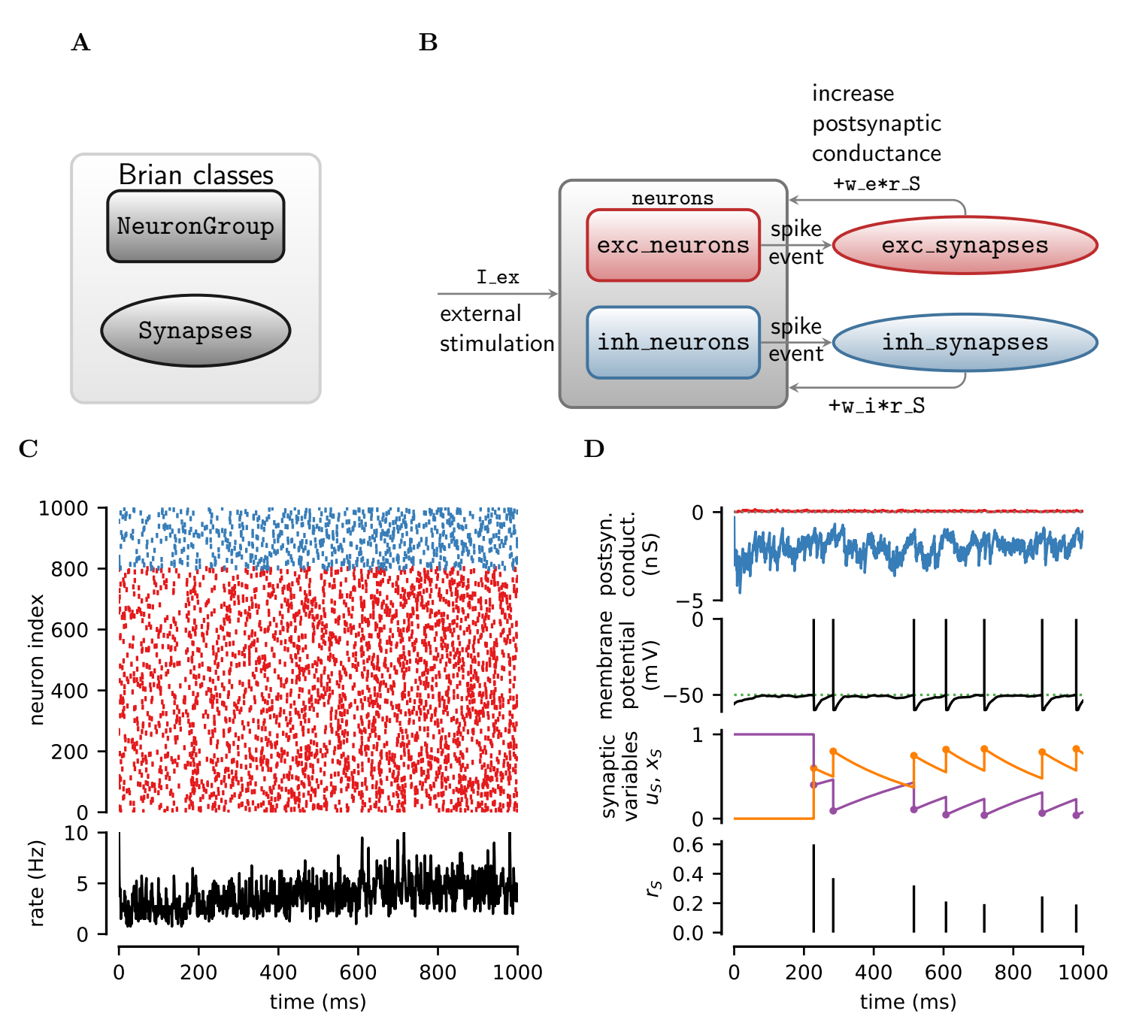

Slide 33
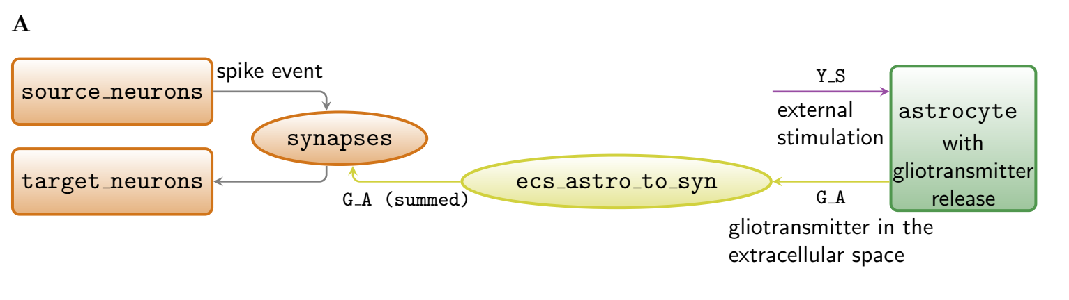
open loop astroctye

Slide 34
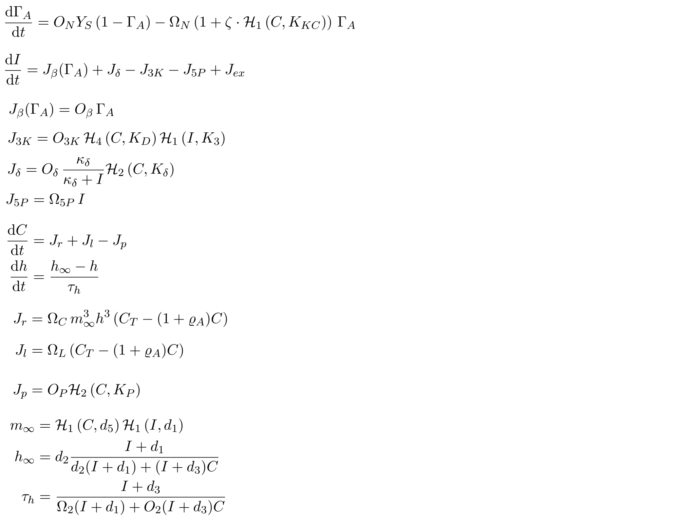
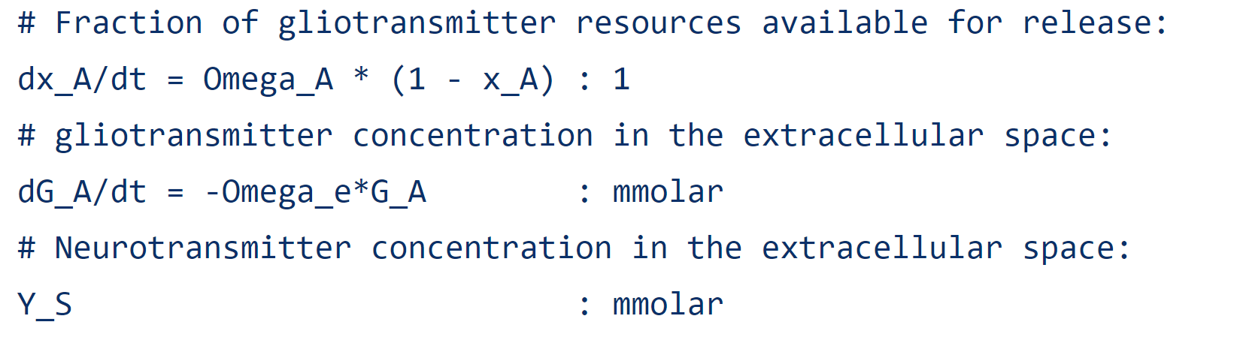
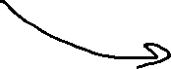
Astrocyte equations
Fraction of activated astrocyte receptors
Intracellular IP_3
Diffusion between astrocytes
Ca^2+-induced Ca^2+ release

Slide 35
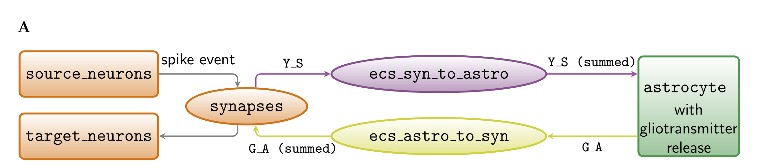
Close loop

Slide 36
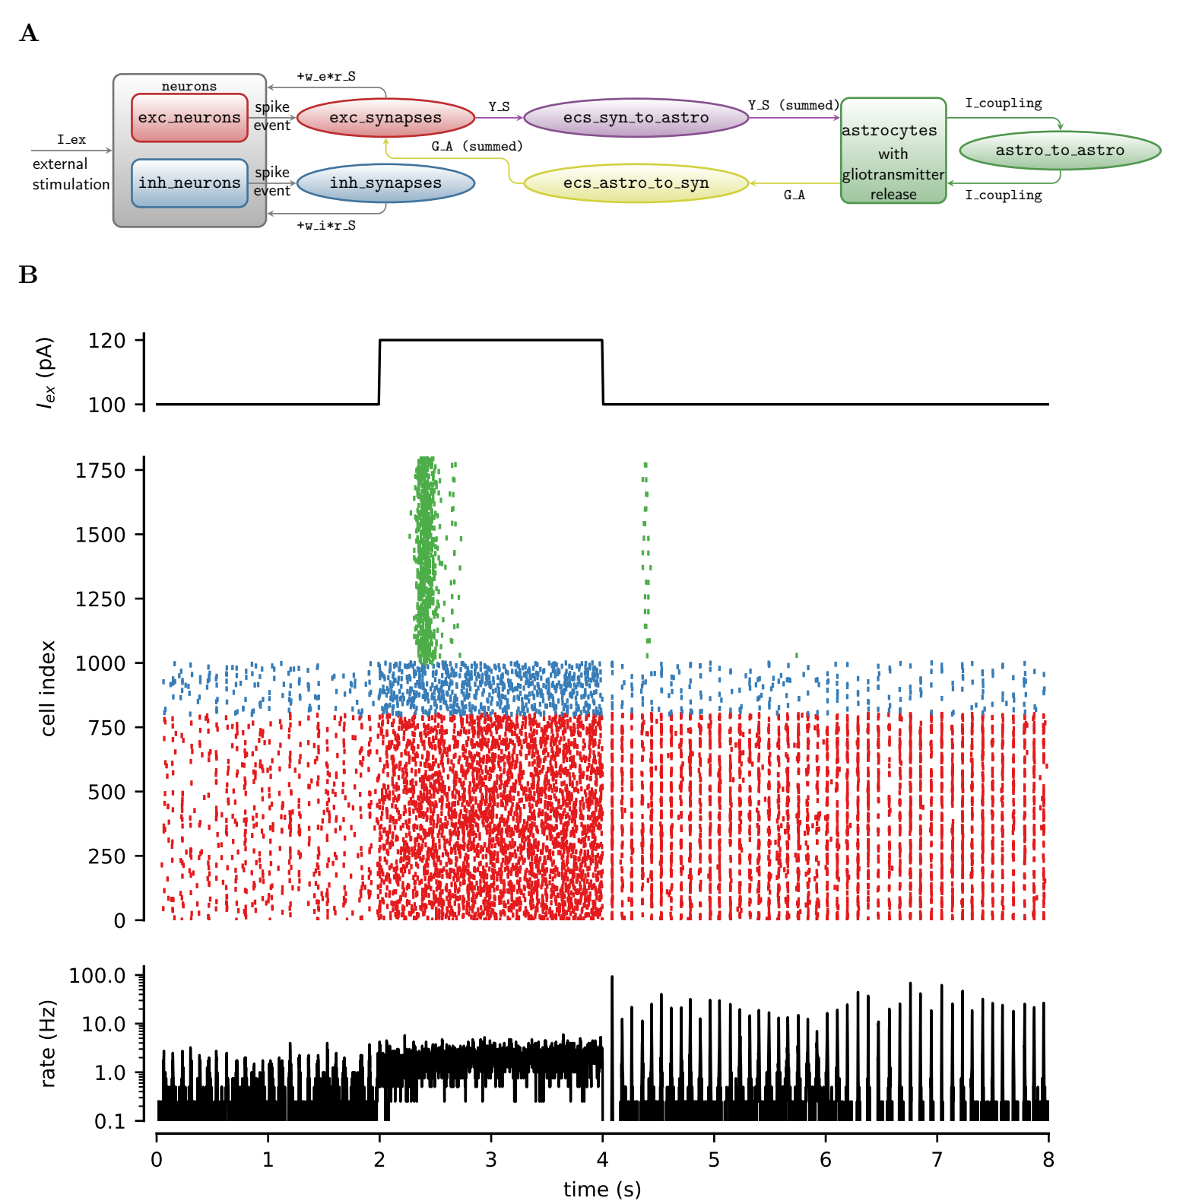
Whole network
Simulations of neuron-glia network for a rectangular-pulse increase of external current (I_ex, top panel).
The raster plot (middle panel) shows the firing activity of 25% out of all excitatory (red) and inhibitory neurons (blue) of the network, and gliotransmitter release (green) from an equal fraction of astrocytes. The network-averaged firing rate is shown at the bottom. Neural activity dramatically changes from asynchronous low-firing activity to synchronous high-firing activity following gliotransmitter release from astrocytes during the period of high stimulation (2 ≤ t < 4 s).

